Slide 1

Alec Fredriksson
Shannon Lai
Simond Liu
Wilson Lam

Slide 2
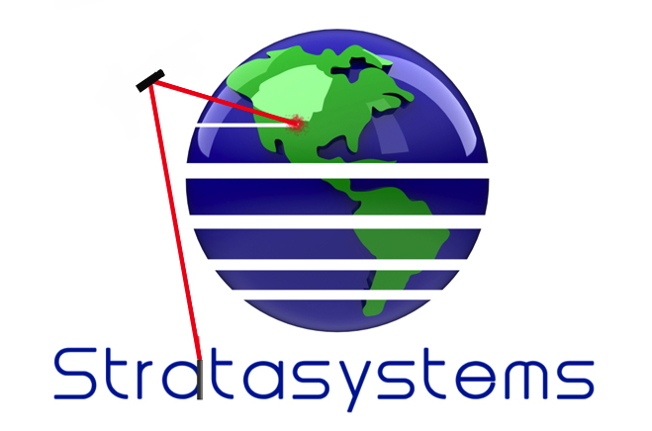
Stratasystems Logo
strata - a series of layers of rock in the earth

Slide 3


Concept 1: Cable Retractor
Problem: earbud cords get tangled
Solution: retractor winds up extra cord and stores in circular housing

Slide 4

Concept 2: Pocket Ruler
Problem: rulers lack portability
Solution: measure distance by rolling a wheel over a surface. Gears in the device translate this motion to a dial, which displays the total distance.

Slide 5


Concept 3: Wallet Card
Problem: the wallet is outdated
Solution: modernized design where instead of opening your wallet, cards can be inserted into a slot. Each card can then be ejected when needed.

Slide 6
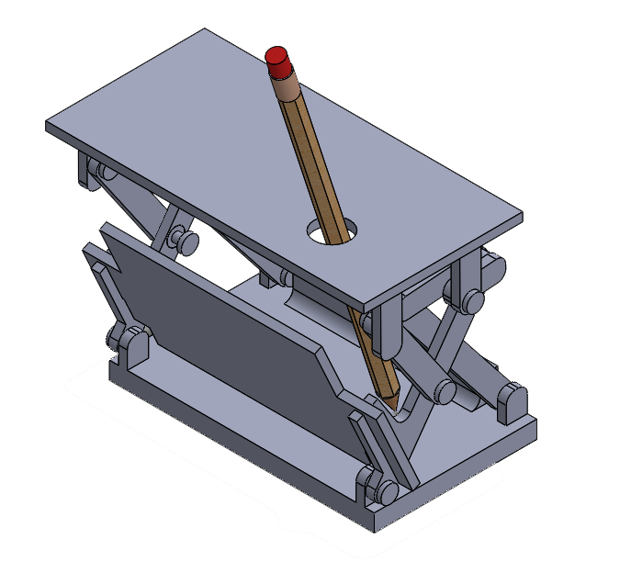
Concept 4: Pencil Holder
Motivation: allow students to explore 4 bar linkages in a hands on setting

Slide 7
Questions?

